Slide 1


Customer Retention Case Study

Slide 2
Problem Statement
E-retail factors for customer activation and retention: A case study from Indian e-commerce customers
Customer satisfaction has emerged as one of the most important factors that guarantee the success of online store; it has been posited as a key stimulant of purchase, repurchase intentions and customer loyalty. A comprehensive review of the literature, theories and models have been carried out to propose the models for customer activation and customer retention. Five major factors that contributed to the success of an e-commerce store have been identified as: service quality, system quality, information quality, trust and net benefit. The research furthermore investigated the factors that influence the online customers repeat purchase intention. The combination of both utilitarian value and hedonistic values are needed to affect the repeat purchase intention (loyalty) positively. The data is collected from the Indian online shoppers. Results indicate the e-retail success factors, which are very much critical for customer satisfaction.
.

Slide 3
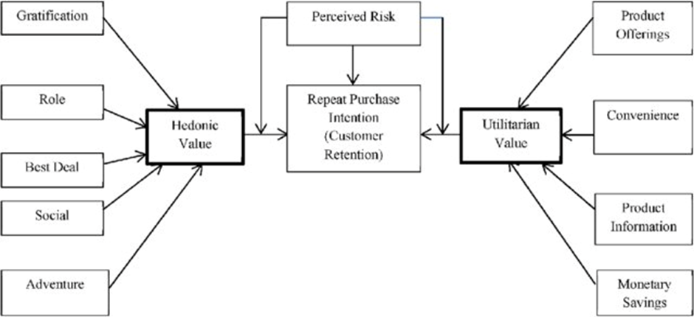
Customer Retention Factors
Data given in the excel sheet needs to be analyzed based on the above mentioned factors.

Slide 4
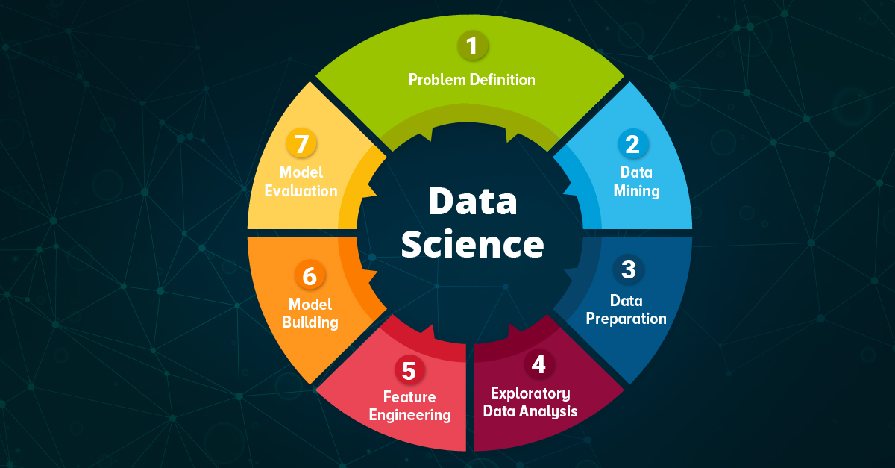
DATA SCIENCE

Slide 5
EDA(Exploratory Data Analysis) Steps
Exploratory Data Analysis is a data analytics process to understand the data in depth and learn the different data characteristics, often with visual means. This allows you to get a better feel of your data and find useful patterns in it.
Data Collection
Data Cleaning ( Handling Missing values & outliners)
3) Univariate Analysis (Bar graph)
4) Bivariate Analysis (Scatterplot, Pairplot, boxplot, Correlation Matrix)

Slide 6
Steps used for Analysis of Data
1)Loading the Data sets
2) Loading the file
3) Checking for the missing values or null values
4)EDA including plotting on graphs , correlation matrix
5) Checking the skewness
6) Removing the outliers
7) Undertaking the training process
8) Model building using various processes

